Slide 1
Data Mining 2 Supervised Learning
Neural Networks
Dr. Shailesh Kumar
ISB/CBA

Slide 2
ML = Optimization?

Slide 3
Typical ML Process
Data
Stats on Data
Parameters
Objective Function
Closed Form Solution
Greedy Algorithm
Iterative Solution

Slide 4
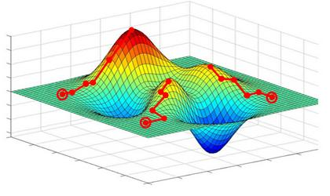
Initialization Matters!
PCA
Fisher
K-Nearest Neighbor
Parzen Window
Bayesian Classifier
Naïve Bayes Classifier
K-Means Clustering
Mixture of Gaussians
Decision Trees
Perceptron
Logistic Regression
Neural Networks
Non-Parametric?
Closed Form Solution?
Greedy Algorithm?
Iterative Algorithm?

Slide 5
Neural Networks

Slide 6
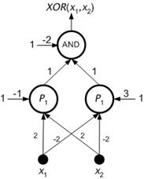

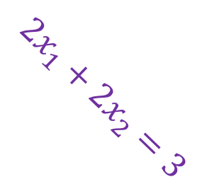
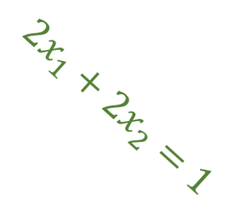
XOR Neural Network
$$2x_{1}+2x_{2}=3$$
$$2x_{1}+2x_{2}=1$$
$$x_{1}$$

Slide 7
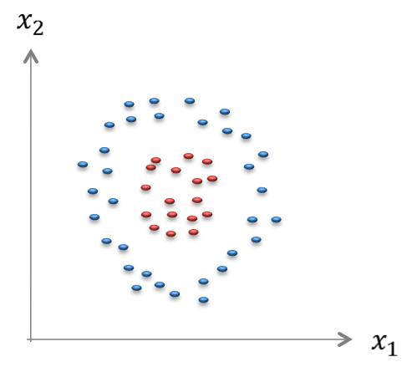
Multi-Layer Perceptron

Slide 8


Multi-Layer Perceptron
$$w_{2,1}^{(1)}$$
$$w_{2,3}^{(0)}$$

Slide 9
Generalized + Logistic
Generalized Linear Discriminant
Logistic Generalized Linear Discriminant

Slide 10
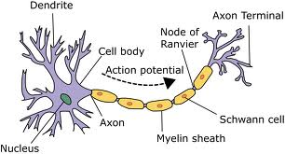
Anatomy of Each Neuron

Slide 11
Anatomy of Each Neuron
ACTIVATION of k^{th} a NEURON in the NEXT LAYER
ACTIVATION of j^{th} NEURON in the CURRENT LAYER
WEIGHTS (Parameters)
ACTIVATION FUNCTION
TRANSFER FUNCTION

Slide 12
Activation Functions

Slide 13
Hyperbolic Activation Function

Slide 14
Output Layer Backprop

Slide 15
Hidden Layer back-prop

Slide 16
Mode 1 – Feed Forward x → y
There is no notion of “STATE” or “MEMORY” in this network!

Slide 17
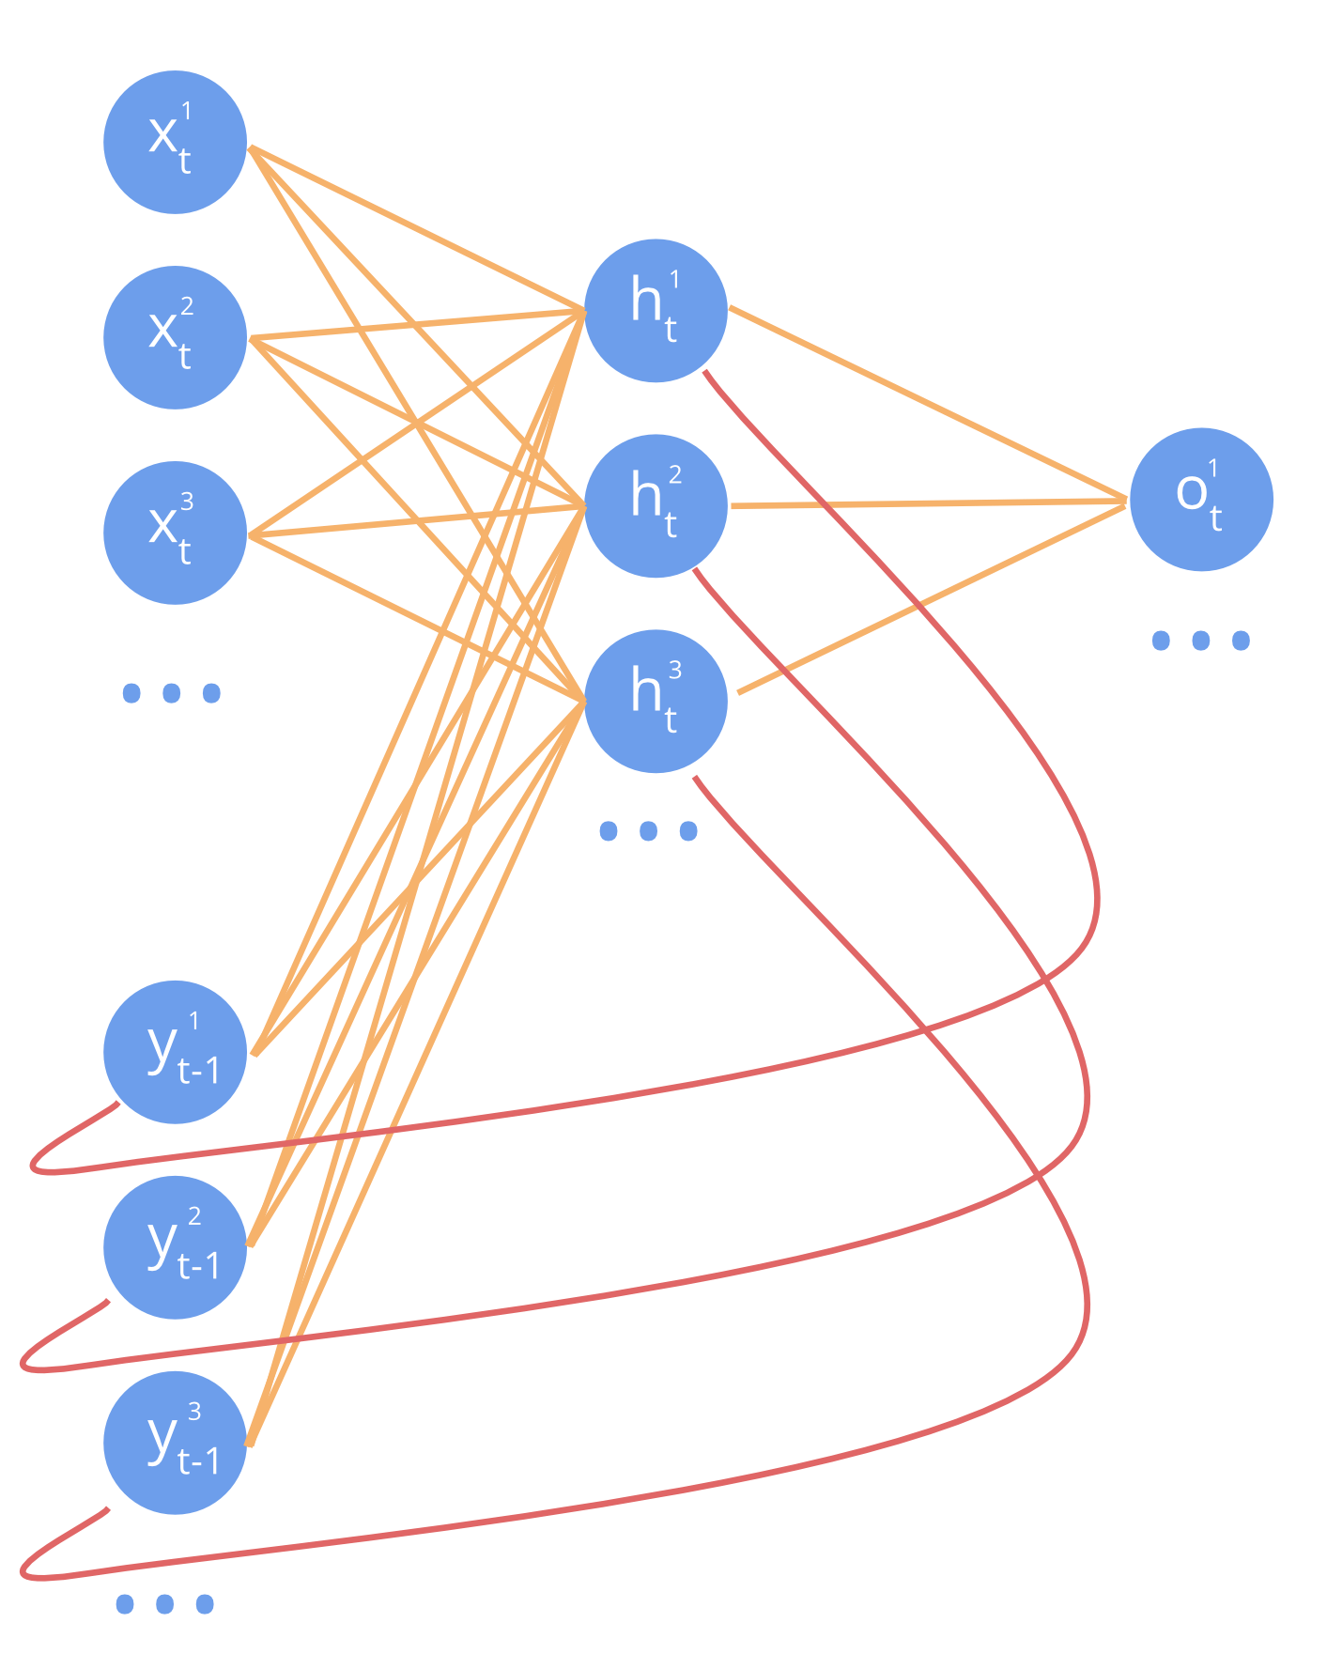
MODE 2 – Recurrent Neural Nets
Networks Remember the Previous “STATE”

Slide 18
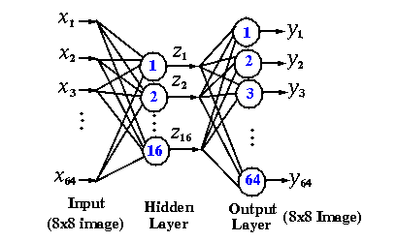
MODE 3 – Compression Network
INPUT = OUTPUT (Non-Linear PCA)

Slide 19
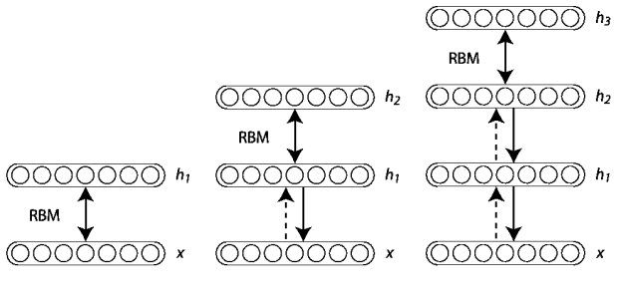
MODE 4 – Deep Belief Network
Multi-Layer Compression with Sparse Coding
Learning a Hierarchy of Features

